Slide 1
Sarz++
A text Adventure game
Sarah Black · Riley Clarkson · Zac Gallagher · ani krishnan

Slide 2
The game
Every adventure is unique
Pick up items for survival
Battle enemies

Slide 3
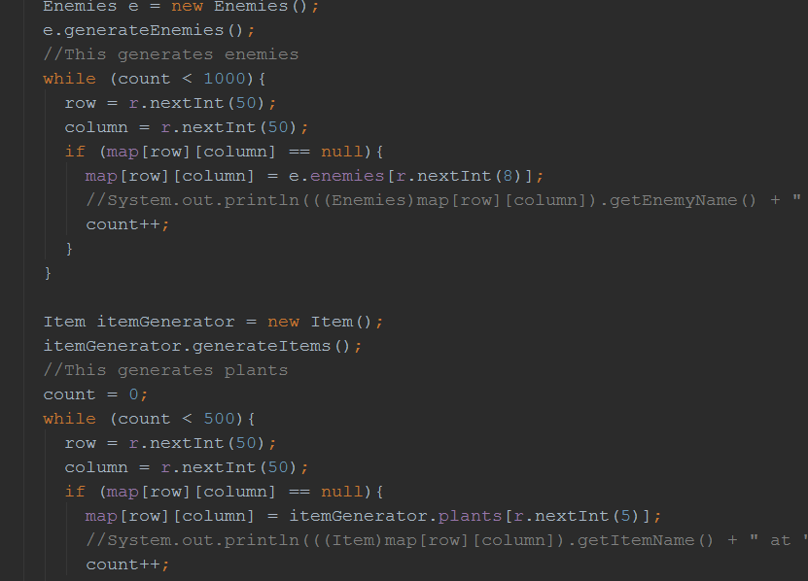
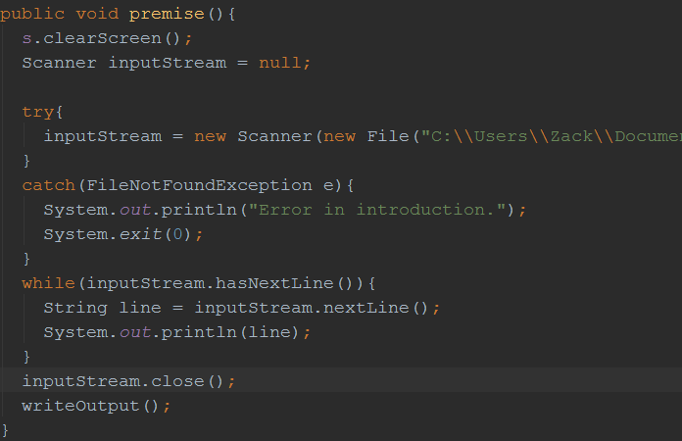
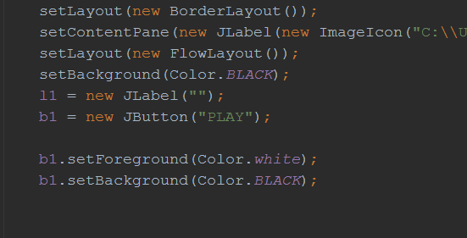
The code: Start Screen, Premise, and map generation
Start Screen
Gui
Extends Jframe
Uses a super call
Uses animation
“Play” Button
Uses interface
Game moves on to premise
Premise
Prints out premise
Input stream from text file
Creates new user
Asks for user input
Name
Starting Item
Map Generation
Array
User navigates around map
Switch cases for user navigation

Slide 4
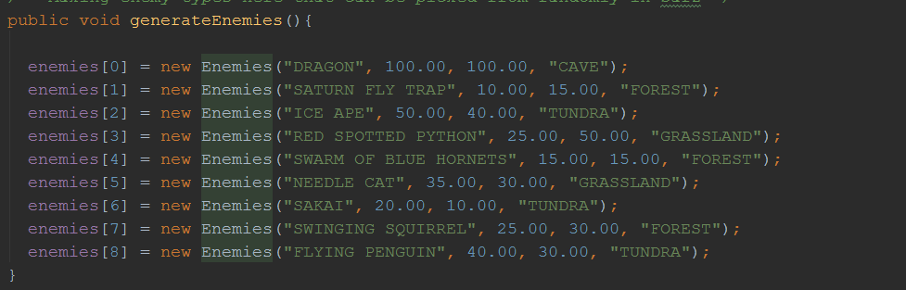
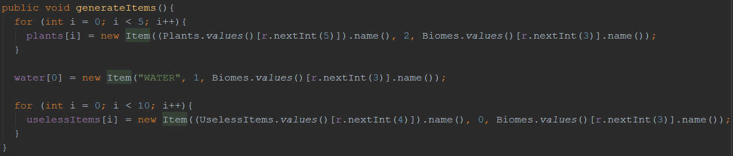
The Code: Enemies and Items
Enemies
Arrays
Has hit points, health points, location, and name attributes
Getters/Setters
User battles against them
Items
Arrays
Enums: Plants, Biomes, Useless Items
Generated randomly
User needs at least 2 waters and two plants to win

Slide 5
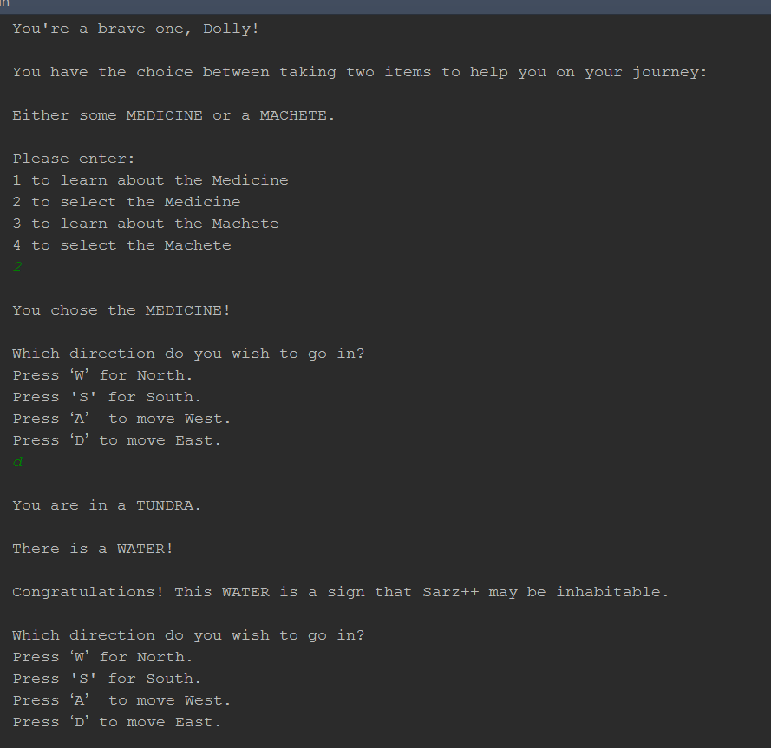
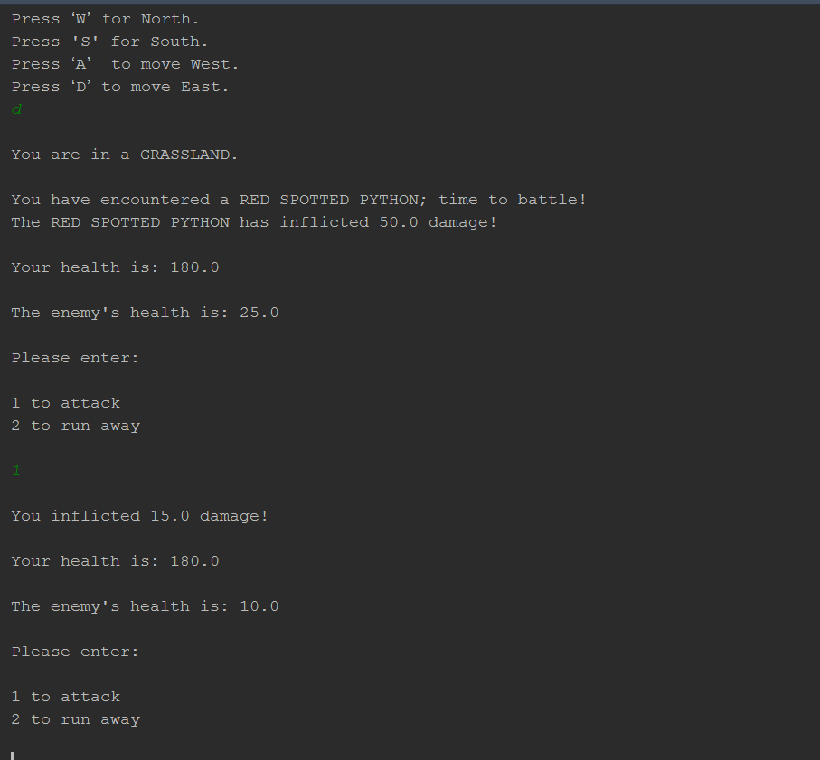
The Demo

